Slide 1


HKBK COLLEGE of ENGINEERING Department of Computer Science and Engineering Final Year Project Presentation
Employee Review Analysis Framework Based On
Cultural Fit Using Text Analytics on Glassdoor Data
By
Akshay Raina (1HK12CS007)
B.Roopini (1HK12CS017)
Mohammad Talha (1HK12CS047)
Mufida Khanam (1HK12CS058)
Under the Guidance of
Pushpa Mohan
Assoc. Professor, CSE Dept , HKBKCE

Slide 2
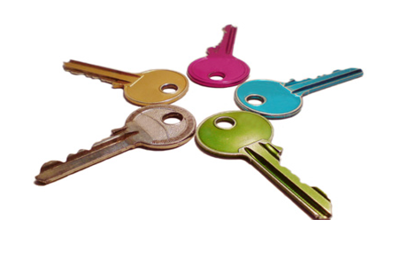
Abstract
Our project mainly focuses around the Employee Review Analysis industry. Employee’s reviews focuses on various cultural parameters that comprises of the knowledge gathered from the web from Human Resources Analytics domain.
Analytics of these employee’s reviews empowers companies and job seekers to understand the cultural fit of a person in an organization. Prediction of the level of various companies based on company culture is done by using the collected reviews.
Employee Review Analysis Framework comprises of the information gathered from web - Glassdoor which allows reviewing, rating and providing insights on various cultural topics etc.
The data is unstructured and contains various reviews, ratings, insights etcetera which is structured into Review Dataset containing a thousands of observations with various cultural attributes thereby defining the cultural fit of an organization.

Slide 3

Objectives
To get good coverage of training examples for each label (ie, For each culture parameters) used.
To get good coverage of training examples for each company based on culture fit analysis.
To get good coverage of training examples for companies across different domains such as Service-Based companies, Product-Based Companies , Travel-Based companies etc.
Main objective is to ensure that most of the patterns of the examples of Cultural Fit are covered.

Slide 4
Difference B/W Existing and Proposed Systems
Existing System | Proposed System
Existing system includes predicting company environments based on salaries, interviews, benefits, job types etcetera | Proposed system includes predicting culture parameter class on analysing reviews and also provides the companies with useful parameters to improve their office culture.
Existing System considered is Glassdoor - Website | Proposed System is the “Employee Review Analysis Framework Based On Cultural Fit Using Text Analytics on Glassdoor Data”.

Slide 5
Introduction
Glassdoor
The most popular employer and CEO review site right now.
The Current or former employees anonymously rate their companies on a scale of 1– 5 along with a statement of at least one pro and one con of working for the organization.
Apart from reviews, users are also able to submit information regarding interview questions they faced as well as reporting salary information.
It is an extremely handy tool which people can use to choose the right company and job to apply for (by using the reviews and salaries section).

Slide 6
What do you mean by Cultural Fit?
Cultural fit deals with how an employee is fit in or with an organization’s culture.
An Employee wish to work for: the features, language, and morals that exist within the organization’s culture.
An employee with good cultural fit will work well within the environment of the company.
The Company seeking to achieve high performance from their employees are progressively more turning towards cultural fit as part of their enrollment methods.

Slide 7
What are Culture Parameters or Labels ??
The Culture Parameters or labels are the tags or names that are used to describe the culture fit of an employee in an organization more precisely.
Some of the examples of Culture Parameters that evaluate the culture fit are :
Work-Life Balance, Safety, Compensation and Benefits etc.
We evaluate the cultural Fit of an employee in an organization using these 11
culture parameters namely: Work-Life Balance, Career Growth , Development,
Compensation and Benefits, Training, Management ,Safety, Team Spirit ,
Work place, Training and Self-development.

Slide 8
Overview
Determination of cultural parameter classes such as Security, Compensation and Benefits, Work-Life Balance, etc. based on cultural fit of an employee in a company for a job role.
Used Glassdoor’s public API for crawling of 3 tags: ‘pros’ , ‘cons’, ‘name’, obtained in JSON format using Java code, each sentence called a “Document”.
About 1000 companies data was crawled, each JSON object had 8-10 company data, so 1000 x 10 company data in total.
Then, used Open NLP Sentence Splitter to split 10,000 company data to obtain a total of 60,756 documents.
Used a Tool (Python Shell Script) for Training Data creation wherein we tagged the documents into cultural parameter classes (manually).
Training Data Output: Tagging Keys and Labels or cultural Parameter Classes.

Slide 9
Classification is the process which consists of a set of predefined classes and helps determine to which class a new object belongs to.
Classifier is the one that performs data classification into two phases: training and testing phase (infant)
SVM (support Vector Machine) is a discriminating classifier formally defined by a separating hyperplane. In other words, given a labelled Training Data , the algorithm outputs optimal hyperplane which categorizes new examples.
We have twelve labels.
Database :Using MySQL Database for collection of non-classified, classified data, and data for aggregation and reports generation for viewing in User Interface (Web Application).

Slide 10

Software Requirements Specification
Analysis on Requirements is performed which leads to understanding the problem that software system has to solve.
The importance of requirements analysis is to recognize or identify what is needed from the system, rather than the path to achieve its goals.
This stage has two key activities:
1) Understanding of problem or analysis of problem .
2) Requirement specification.

Slide 11
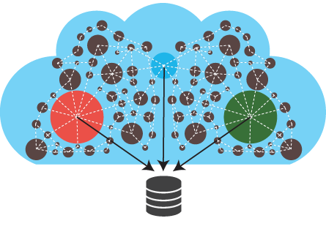
Functional & Non-Functional Requirements
Functional Requirements
Option for request query, User search terms which will calls a query.
Connects to the Glassdoor using Glassdoor public API and searches the glassdoor reviews related to query and collect all reviews in Glassdoor–>service collector->DB-System.
It maps the glassdoor documents(ie, sentences) to any of the identified labels using SVM classifier.
Non-Functional Requirements
Reduce processing time for prediction.
Efficient and good performance when compared to existing system.

Slide 12

Performance Requirements
Precision-Recall metrics are used to evaluate classifier output quality.
In information retrieval, precision is a measure of result relevancy, while recall is a measure of how many truly relevant results are returned.
A system with high recall but low precision returns many results, but most of its predicted labels are incorrect when compared to the training labels.
A system with high precision but low recall is just the opposite, returning very few results, but most of its predicted labels are correct when compared to the training label.
Precision (P) is defines as the number of true positives (Tp) over the number of true positives (Tp) plus the number of false positives (Fp).
P=Tp
Tp + Fp

Slide 13

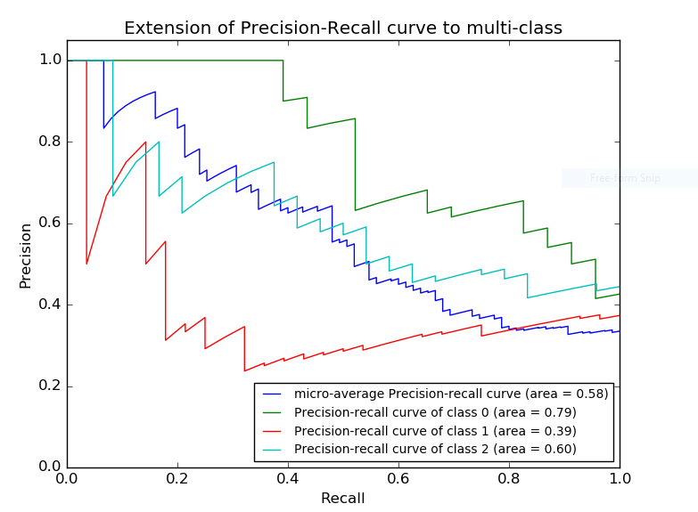
Contd…
Recall (R) is defined as the number of true positives(Tp) the number of true positives (Tp) plus the number of false negatives (Fn).
R=Tp
Tp + Fn
Precision-recall curves are typically used in binary classification to study the output of a classifier, for multi class classifier it is necessary to binarize the output.
One curve can be drawn per label, but one can also draw a precision-recall curve by considering each element of the label indicator matrix as a binary prediction.

Slide 14
Hardware and Software Specifications
Hardware Specifications
Software Specifications
Any CPU with speed 1.8gHz
Min 1GB RAM, Recommended 2 GB RAM.
1GB space in Hard disk include prerequisite software.
Basic Hardware needs like Monitor, Mouse, and Keyboard.
Language and IDE -> Advanced Java (JDK1.8), NetBeans IDE 8.0.2.
Library -> JDBC (Java Database Connectivity Library)
Server -> Apache Tomcat 8.0.15.0, Jetty Runner 9.2.9

Slide 15

SYSTEM MODULES
The Proposed System Consist of 3 Modules namely :
Glassdoor -Service Collector: Glassdoor-Service collector is a module which helps to collect all related reviews for the query. User will query the term, it will send the query to the Glassdoor API-> Glassdoor->MySQL for searching. The searched related reviews are collected and stored in array for next process.
Normalization: Analyzed Structured reviews are generally in sentence format, with URLs specified for images or blog articles. To get data that is in usable format we remove the stop words that contains general terms like a, the, etc. and emotions.
Classification: Classification module uses “ SVM algorithm ”. First we will use SVM to classify based on train data.

Slide 16
Design Constraints
The reviews that need to be classified into cultural parameter classes should be verified ones as they determine the impression of any company and its environment.
Huge amount of data should be collected for training data, the more precise it is the better are the results obtained.
Storing of collected data into MySQL should be done accurately.

Slide 17
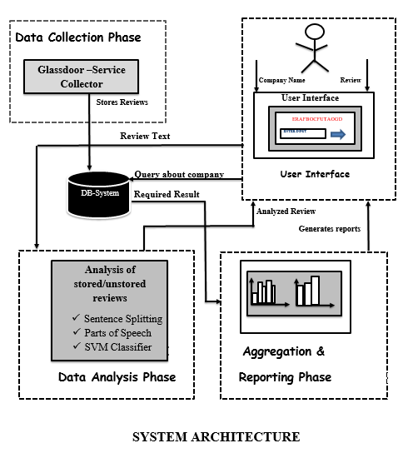
System
Architecture

Slide 18
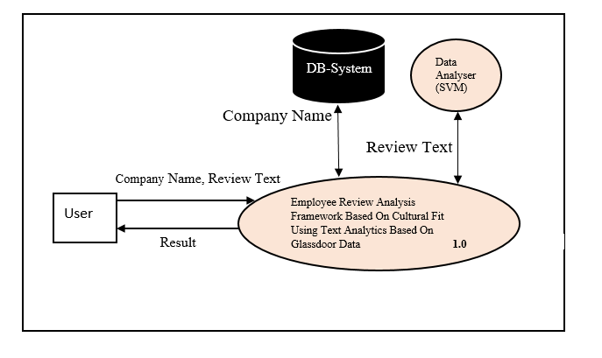
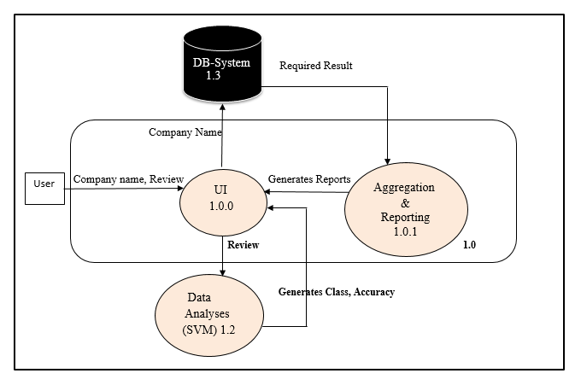

Data Flow Diagrams
Level 0
Level 1

Slide 19
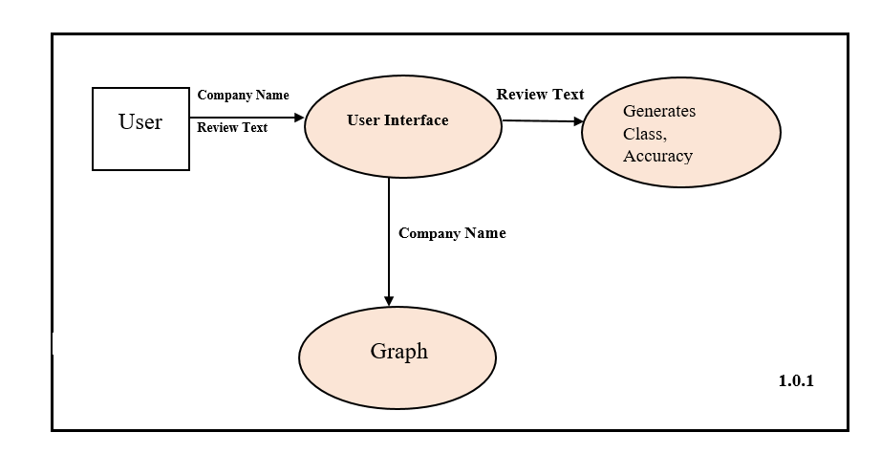
User Interface 1.0.0 –DFD
1.0.0

Slide 20
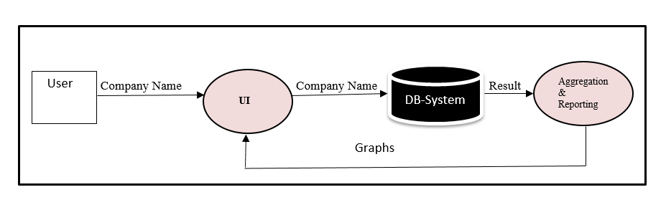
Aggregation and Reporting 1.0.1 -DFD
1.0.1

Slide 21
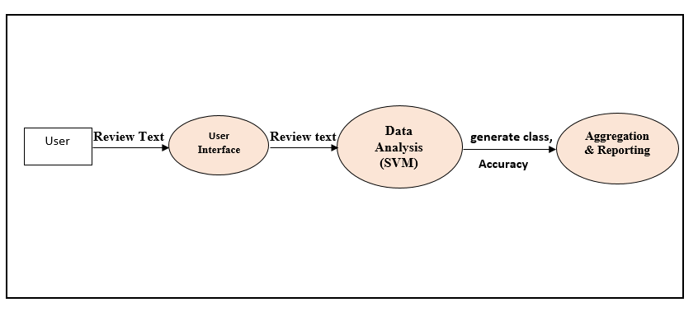
Data Analyses (SVM) level description 1.2-DFD
1.2

Slide 22
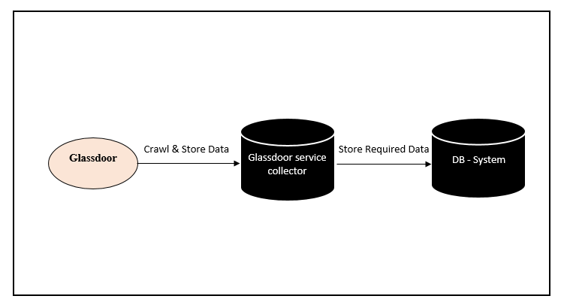
Glassdoor Service-Collector level Description 1.3-DFD
1.3

Slide 23
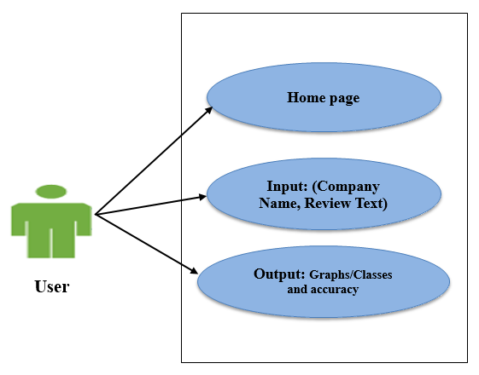
Use-Case Diagrams
Use-Case Diagram
For User

Slide 24
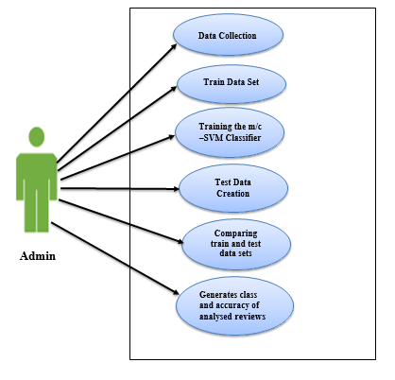
Use-Case Diagram
For Admin

Slide 25
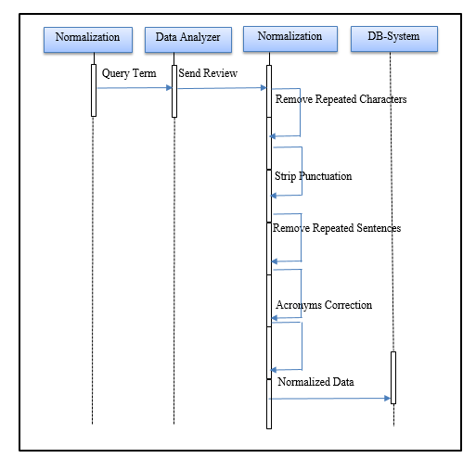
Sequence Diagram
Sequence Diagram for
Normalization

Slide 26
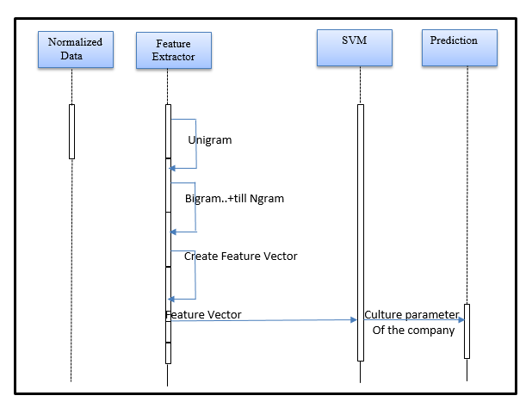
Sequence Diagram
for
Feature Vector

Slide 27

Implementation
Implementation used:
Programming Platform | Java Programming Language
Operating System | Microsoft Windows
Application Platform | NetBeans IDE 8.0.2
Servers | Tomcat , Jetty Runner
Algorithm | Support Vector Machine (SVM)

Slide 28

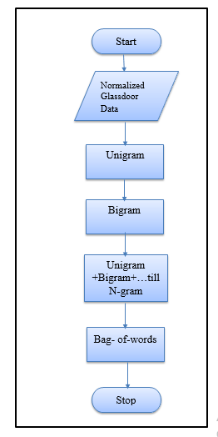
Flowchart For Feature Extraction

Slide 29
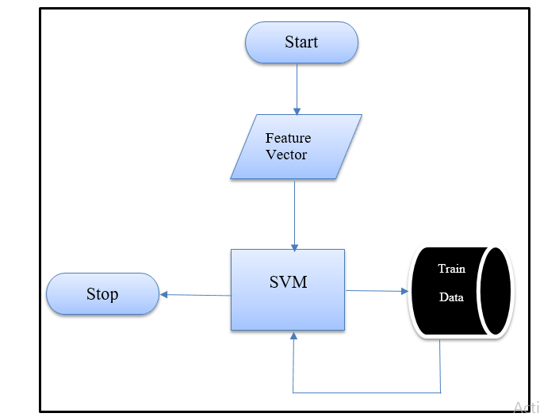
Flowchart for Data classification

Slide 30
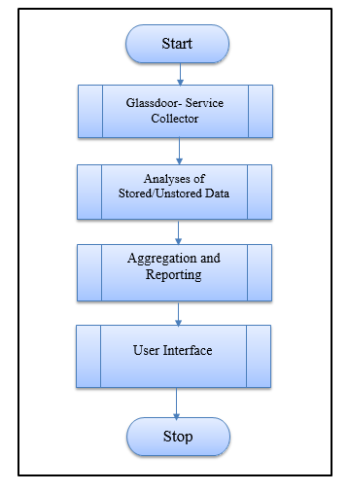
Overall Flowchart

Slide 31
Future Scope
The implementation of ERAF needs to be done in order to make it full-fledged software with all the features and detailed study on API is needed for the performance improvements.
We propose to use the concept of Text Analytics for performing Machine Learning for data classification.
The Glassdoor Data is highly confidential and prior user keys must be obtained from Glassdoor in order to use their resources.
We can implement the Cultural Parameter Analysis screen on giving company name directly which in turn picks up the corresponding review and gets class and accuracy.
Analysis for only three thousand eighteen companies is done, more companies can be added in the future. On entering content in the textbox keyboard enter feature can also be implemented in addition to the mouse that I use currently.

Slide 32
Conclusion
With the successful implementation of the ERAF, end users can easily identify the best company based on cultural fit .
It is clear that in such a way Company Data and Review Data could offer added value, increased efficiency and add more knowledge about the company to the user.
However, the technical concept was tried and stood up to the tests and showed that it is a technology which could be used from here on by any person seeking a job. The ERAF showed clearly that there was a need for using multiple API’S to support ERAF modules.

Slide 33

References
Introduction to Machine Learning ,Second Edition Ethem Alpaydın The MIT Press Cambridge, Massachusetts London, England.
M Ashrafet. al. "Multinomial Naive Bayes for Text Categorization Revisited" , University of Waikato
D. O. Computer, C. wei Hsu, C. chung Chang, and C. jen Lin. A practical guide to support vector classification chih-wei hsu, chih-chung chang, and chih-jen lin. Technical report, 2003.
Hastie, T., Tibshirani, R., & Friedman, J. (2001). The Elements of Statistical Learning. New York, NY, USA: Springer New York Inc
Russell, S. 1., Norvig, P., & Davis, E. (2010) Artificial intelligence: A modern approach. Prentice Hall.
http://searchdatamanagement.techtarget.com/definition/data-analytics .
https://www.techopedia.com/definition/26418/data-analytics.
https://www.lynda.com/Excel-tutorials/Foundations-Data-Analysis-Understanding-basics-data-analytics/423403-2.html

Slide 34


